Slide 1
Apon Customer Survey Data Analysis
Kazi Tahsinul Haque

Slide 2
Findings
Participant Information
Apon Infromation
Customer Information
Reason for Shopping from Apon
Product Sale Percentage
Reason for not Shopping from Apon

Slide 3
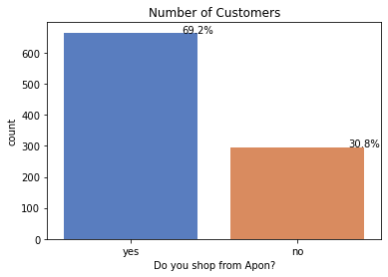
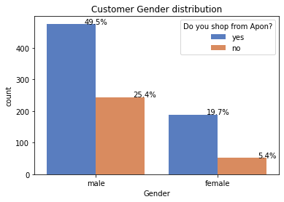
Participant Information

Slide 4
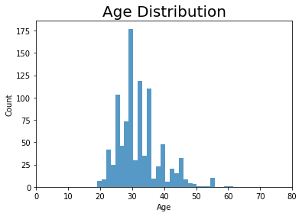
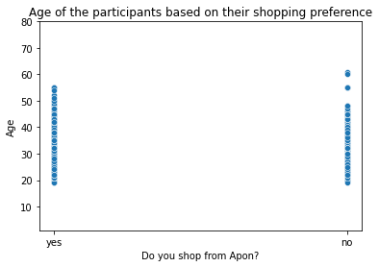
Participant Information

Slide 5
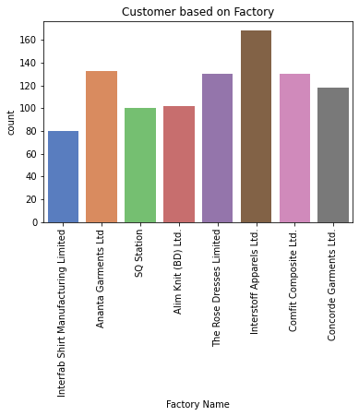
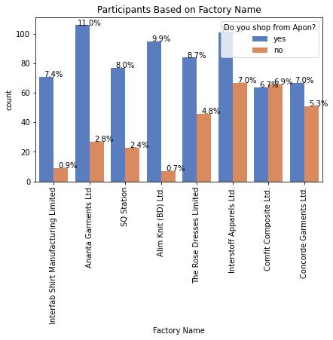
Participant Information

Slide 6
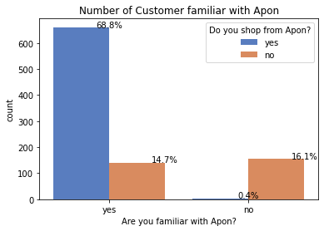
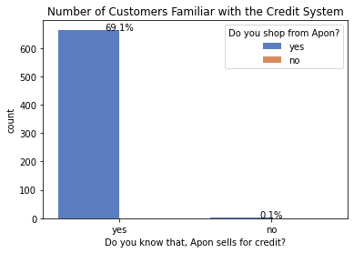
Apon Information

Slide 7
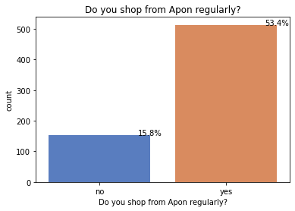
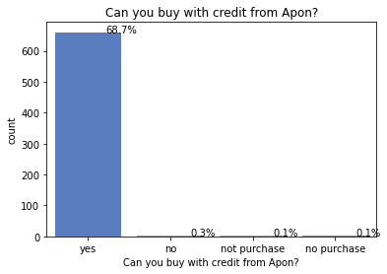
Customer Information

Slide 8
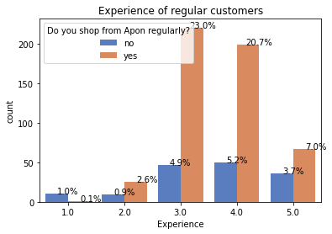
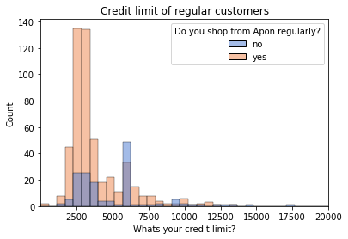
Customer Information

Slide 9
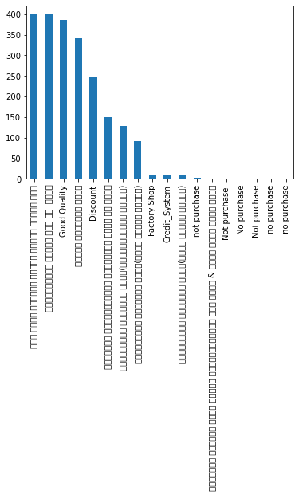
Reason for shopping with Apon

Slide 10
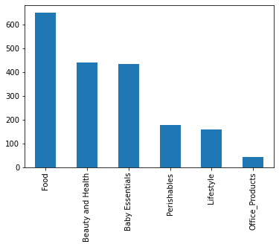
Product Sale Percentage

Slide 11
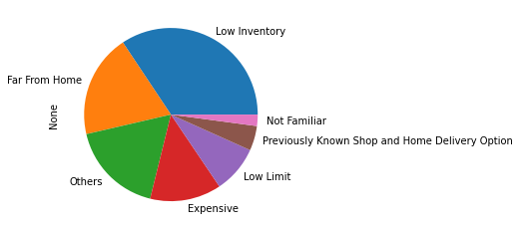
Reason for not shopping from Apon

Slide 12
THANK YOU
Kazi Tahsinul Haque
tahsinul.hq4@gmail.com
https://github.com/tahsinulhq

